Slide 1

Overview of XYZ Car Manufacturing Company and New Model Launch

Slide 2
1. Introduction of the Company
Agenda
2. List of Cars the Company Sells
3. Introduction of the New Car Launched
Explore the Company's Overview and New Car Details
4. Key Features of the New Car
5. Conclusion

Slide 3


Introduction of the Company
Toyota Motor Corporation is a Japanese multinational automotive manufacturer known for its commitment to quality and innovation. Founded in 1937, Toyota has grown to become one of the largest car manufacturers in the world. The company is renowned for its pioneering role in the development of hybrid vehicles and its focus on sustainable mobility.

Slide 4
Company History
1. Toyota was founded in 1937 by Kiichiro Toyoda as a spinoff from Toyota Industries.
2. The company gained worldwide recognition with the launch of the Toyota Corolla in 1966.
3. Toyota has been a leader in hybrid technology with the introduction of the Prius in 1997.

Slide 5

Mission and Vision
1. Toyota's mission is to 'produce high-quality vehicles that enhance the lives of customers.'
2. The vision emphasizes sustainability and innovation in every aspect of automotive production.
3. Core values include respect for people, continuous improvement, and excellence.

Slide 6
Market Presence
1. Toyota is one of the largest automotive manufacturers globally, often battling for the top position with Volkswagen.
2. It has established a strong presence in various markets, including North America, Europe, and Asia.
3. Key achievements include being the first car manufacturer to sell over 10 million vehicles in a single year.

Slide 7

List of Cars the Company Sells
Toyota offers a diverse range of vehicles catering to different customer needs and preferences. From sedans to SUVs and electric vehicles, Toyota ensures quality and reliability across all models. This comprehensive lineup showcases Toyota's commitment to innovation and consumer satisfaction.

Slide 8

Sedans
1. Toyota Camry - Known for its reliability and fuel efficiency.
2. Toyota Corolla - A compact sedan that blends style and performance.
3. Toyota Avalon - A full-size sedan offering luxury and comfort.

Slide 9

SUVs
1. Toyota RAV4 - A popular compact SUV known for its spacious interior.
2. Toyota Highlander - A mid-size SUV that accommodates families with ease.
3. Toyota Land Cruiser - A luxurious off-road SUV designed for rugged terrains.

Slide 10

Trucks
1. Toyota Tacoma - A mid-size truck known for its off-road capabilities.
2. Toyota Tundra - A full-size truck offering powerful performance.
3. Toyota Hilux - A rugged pickup truck favored in various markets globally.

Slide 11

Electric Vehicles
1. Toyota Prius - A pioneer in hybrid technology and eco-friendly driving.
2. Toyota bZ4X - An electric crossover SUV focusing on innovative design.
3. Toyota Mirai - A hydrogen fuel cell vehicle leading the way in green technology.

Slide 12
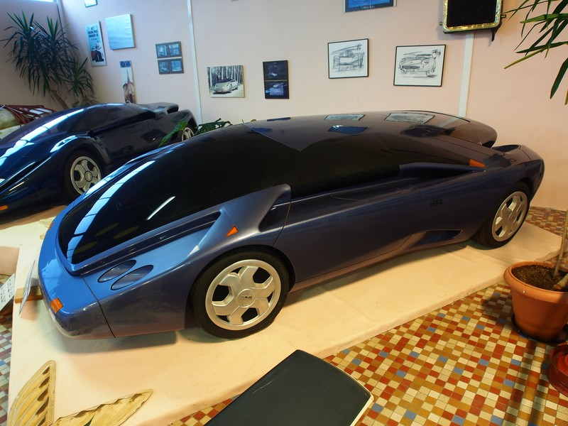
Introduction of the New Car Launched
Toyota has recently launched the all-new Toyota bZ4X, marking its entry into the electric vehicle market with a revolutionary design and state-of-the-art technology. This model aims to redefine the future of driving by prioritizing sustainability without compromising performance. The bZ4X represents Toyota's commitment to achieving carbon neutrality by 2050.

Slide 13
Model Name
The new car model introduced is the Toyota bZ4X, an all-electric compact SUV. The name 'bZ' stands for 'Beyond Zero,' reflecting Toyota's vision for a carbon-neutral future. As part of Toyota's new electric vehicle lineup, the bZ4X aims to offer a greener alternative for consumers.

Slide 14
Features
The Toyota bZ4X features a powerful electric drivetrain, offering up to 250 miles of range on a single charge. It is equipped with advanced technology, including an intuitive infotainment system and extensive safety features such as Toyota Safety Sense. Additionally, its spacious interior provides comfort for up to five passengers, making it ideal for families.

Slide 15
Target Audience
The target audience for the Toyota bZ4X includes environmentally conscious consumers seeking a reliable electric vehicle. This model appeals to tech-savvy individuals who appreciate innovative features and advanced safety technologies. Additionally, families looking for a sustainable yet spacious vehicle find the bZ4X appealing for their daily needs.

Slide 16
Launch Date and Reception
The Toyota bZ4X was officially launched in May 2022, with significant anticipation in the electric vehicle market. Initial reception has been positive, with consumers praising its design, range, and technology. Many reviews highlight the vehicle's commitment to sustainability and its potential to reshape the automotive landscape.

Slide 17
1. Recap of the Company Overview
Conclusion
2. Review of Cars Offered
3. Details of the New Model
Summary of Key Points
4. Considerations for Potential Buyers
5. Final Thoughts

